Slide 1
Software Design
Static Modeling using the Unified Modeling Language (UML)

Slide 2
What is UML?
Why should I bother? Do people really use UML?
What is a UML class diagram?
What kind of information goes into it?
How do I create it?
When should I create it?

Slide 3
Design phase
design: specifying the structure of how a software system will be written and function, without actually writing the complete implementation
a transition from "what" the system must do, to "how" the system will do it
What classes will we need to implement a system that meets our requirements?
What fields and methods will each class have?
How will the classes interact with each other?

Slide 4
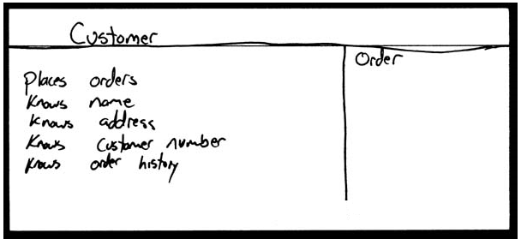
How do we design classes?
class identification from project spec / requirements
nouns are potential classes, objects, fields
verbs are potential methods or responsibilities of a class
CRC card exercises
write down classes' names on index cards
next to each class, list the following:
responsibilities: problems to be solved; short verb phrases
collaborators: other classes that are sent messages by this class (asymmetric)
UML diagrams
class diagrams (today)
sequence diagrams
...

Slide 5
Uses for UML
as a sketch: to communicate aspects of system
forward design: doing UML before coding
backward design: doing UML after coding as documentation
often done on whiteboard or paper
used to get rough selective ideas
as a blueprint: a complete design to be implemented
sometimes done with CASE (Computer-Aided Software Engineering) tools
as a programming language: with the right tools, code can be auto-generated and executed from UML
only good if this is faster than coding in a "real" language

Slide 6
Classes
A class is a description of a set of
objects that share the same attributes,
operations, relationships, and semantics.
Graphically, a class is rendered as a
rectangle, usually including its name,
attributes, and operations in separate,
designated compartments.
ClassName
attributes
operations

Slide 7
Class Names
ClassName
The name of the class is the only required tag in the graphical representation of a class. It always appears in the top-most compartment.
attributes
operations

Slide 8
Class Attributes
Person
An attribute is a named property of a
class that describes the object being modeled.
In the class diagram, attributes appear in
the second compartment just below the
name-compartment.
name : String
address : Address
birthdate : Date
ssn : Id

Slide 9
Class Attributes (Cont’d)
Attributes are usually listed in the form:
attributeName : Type
A derived attribute is one that can be
computed from other attributes, but
doesn’t actually exist. For example,
a Person’s age can be computed from
his birth date. A derived attribute is
designated by a preceding ‘/’ as in:
/ age : Date
Person
name : String
address : Address
birthdate : Date
/ age : Date
ssn : Id

Slide 10
Class Attributes (Cont’d)
Person
+ name : String
# address : Address
# birthdate : Date
/ age : Date
- ssn : Id
Attributes can be:
+ public
# protected
- private
/ derived

Slide 11
Class Operations
Person
name : String
address : Address
birthdate : Date
ssn : Id
Operations describe the class behavior
and appear in the third compartment.
eat
sleep
work
play

Slide 12
Class Operations (Cont’d)
PhoneBook
newEntry (n : Name, a : Address, p : PhoneNumber, d : Description)
getPhone ( n : Name, a : Address) : PhoneNumber
You can specify an operation by stating its signature: listing the name, type, and default value of all parameters, and, in the case of functions, a return type.

Slide 13
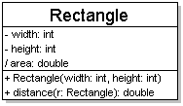
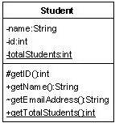
Class operations / methods
operations / methods
visibility name (parameters) : return_type
visibility: + public # protected - private ~ package (default)
underline static methods
parameter types listed as (name: type)
omit return_type on constructors and when return type is void
method example: + distance(p1: Point, p2: Point): double

Slide 14
Depicting Classes
When drawing a class, you needn’t show attributes and operation in every diagram.
Person
Person
Person
name : String
birthdate : Date
ssn : Id
Person
name
address
birthdate
eat()
sleep()
work()
play()
Person
eat
play

Slide 15
Relationships
In UML, object interconnections (logical or physical), are
modeled as relationships.
There are three kinds of relationships in UML:
dependencies
generalizations
associations

Slide 16
Dependency Relationships
A dependency indicates a semantic relationship between two or
more elements. The dependency from CourseSchedule to Course exists because Course is used in both the add and remove operations of CourseSchedule.
CourseSchedule
Course
add(c : Course)
remove(c : Course)

Slide 17
Generalization Relationships
Person
A generalization connects a subclass
to its superclass. It denotes an
inheritance of attributes and behavior
from the superclass to the subclass and
indicates a specialization in the subclass
of the more general superclass.
Student

Slide 18
Generalization Relationships (Cont’d)
UML permits a class to inherit from multiple superclasses, although some programming languages (e.g., Java) do not permit multiple inheritance.
Student
Employee
TeachingAssistant

Slide 19
Association Relationships
If two classes in a model need to communicate with each other, there must be link between them.
An association denotes that link.
Student
Instructor

Slide 20
Association Relationships (Cont’d)
We can indicate the multiplicity of an association by adding multiplicity adornments to the line denoting the association.
The example indicates that a Student has one or more Instructors:
Student
Instructor
1..*

Slide 21
Association Relationships (Cont’d)
The example indicates that every Instructor has one or more Students:
Student
Instructor
1..*

Slide 22
Association Relationships (Cont’d)
We can also indicate the behavior of an object in an association (i.e., the role of an object) using rolenames.
teaches
learns from
Student
Instructor
1..*
1..*

Slide 23
Association Relationships (Cont’d)
We can also name the association.
membership
Student
Team
1..*
1..*

Slide 24
Association Relationships (Cont’d)
We can specify dual associations.
member of
Student
Team
1..*
1..*
1
president of
1..*

Slide 25
Association Relationships (Cont’d)
A class can have a self association.
next
LinkedListNode
previous

Slide 26
Association Relationships (Cont’d)
We can model objects that contain other objects by way of special associations called aggregations and compositions.
An aggregation specifies a whole-part relationship between an aggregate (a whole) and a constituent part, where the part can exist independently from the aggregate. Aggregations are denoted by a hollow-diamond adornment on the association.
Car
Engine
Transmission

Slide 27
Interfaces
An interface is a named set of operations that specifies the behavior of objects without showing their inner structure. It can be rendered in the model by a one- or two-compartment rectangle, with the stereotype <<interface>> above the interface name.
<<interface>>
ControlPanel

Slide 28
Interface Services
<<interface>>
ControlPanel
Interfaces do not get instantiated. They have no attributes or state. Rather, they specify the services offered by a related class.
getChoices : Choice[]
makeChoice (c : Choice)
getSelection : Selection

Slide 29
Interface Realization Relationship
<<interface>>
ControlPanel
A realization relationship connects a class with an interface that supplies its behavioral specification. It is rendered by a dashed line with a hollow triangle towards the specifier.
specifier
implementation
VendingMachine

Slide 30
Enumeration
An enumeration is a user-defined data type that consists of a name and an ordered list of enumeration literals.
<<enumeration>>
Boolean
false
true

Slide 31
Exceptions
Exceptions can be modeled just like any other class.
Notice the <<exception>> stereotype in the name compartment.
<<exception>> Exception
getMessage()
printStackTrace()
<<exception>> KeyException
<<exception>> SQLException

Slide 32
Packages
A package is a container-like element for organizing other elements into groups.
A package can contain classes and other packages and diagrams.
Packages can be used to provide controlled access between classes in different packages.
Compiler

Slide 33
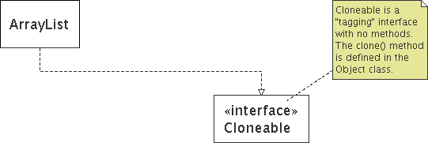
Comments
represented as a folded note, attached to the appropriate class/method/etc by a dashed line

Slide 34
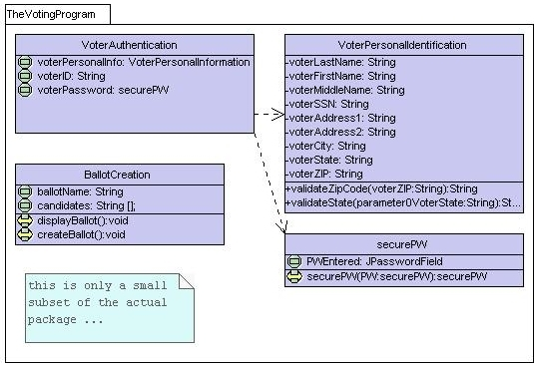
Class diagram example 1

Slide 35
Class diagram example 2
Multiplicity
Customer
1
Simple
Aggregation
Class
Abstract
Class
Rental Invoice
Rental Item
1..*
1
0..1
Composition
Simple
Association
Generalization
Checkout Screen
DVD Movie
VHS Movie
Video Game

Slide 36
Class diagram example 3
StudentBody
Student
1
100
- firstName : String
- lastName : String
- homeAddress : Address
- schoolAddress : Address
+ main (args : String[])
+ toString() : String
Address
- streetAddress : String
- city : String
- state : String
- zipCode : long
+ toString() : String

Slide 37
Tools for creating UML diags.
Violet (free)
http://horstmann.com/violet/
Rational Rose
http://www.rational.com/
Visual Paradigm UML Suite (trial)
http://www.visual-paradigm.com/
(nearly) direct download link: http://www.visual-paradigm.com/vp/download.jsp?product=vpuml&edition=ce
(there are many others, but most are commercial)

Slide 38
Class design exercise
Consider this Texas Hold 'em poker game system:
2 to 8 human or computer players
Each player has a name and stack of chips
Computer players have a difficulty setting: easy, medium, hard
Summary of each hand:
Dealer collects ante from appropriate players, shuffles the deck, and deals each player a hand of 2 cards from the deck.
A betting round occurs, followed by dealing 3 shared cards from the deck.
As shared cards are dealt, more betting rounds occur, where each player can fold, check, or raise.
At the end of a round, if more than one player is remaining, players' hands are compared, and the best hand wins the pot of all chips bet so far.
What classes are in this system? What are their responsibilities? Which classes collaborate?
Draw a class diagram for this system. Include relationships between classes (generalization and associational).

Slide 39
Tips
Don’t try to use all the various notations.
Don’t draw models for everything, concentrate on the key areas.
Draw implementation models only when illustrating a particular implementation technique.

Slide 40
A designer has been assigned a task to model a book subsystem with a class diagram. Knowing that an author writes a book, and then a publisher produces it and a customer purchases it, draw a class diagram to model the subsystem showing class attributes and relationships, associations, roles and multiplicities.

Slide 41
Design a project planning system where a project can be decomposed into activities. An activity involves any number of work products as input and any number of work products as output, and work products may be used with any number of activities as input or output. Activities are related where one predecessor activity may have any number of successor activities, and one successor may have at most one predecessor activity. An activity can be decomposed into tasks. Tasks are related where one predecessor task may have any number of successor tasks, and one successor may have at most one predecessor activity.
Draw a class diagram to model the project planning system showing classes, their relationships (generalization, association, aggregation, composition) as appropriate, roles and multiplicities on associations.

